Slide 1
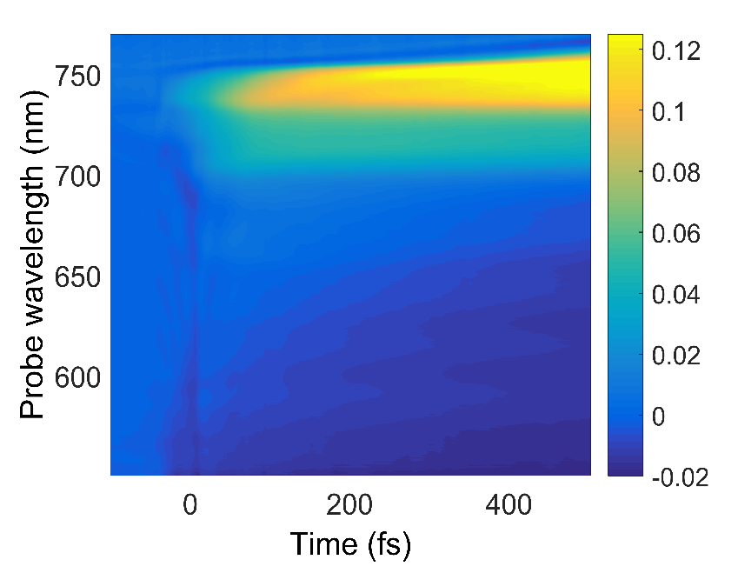
Figure 1
a
b
ΔT/T

Slide 2
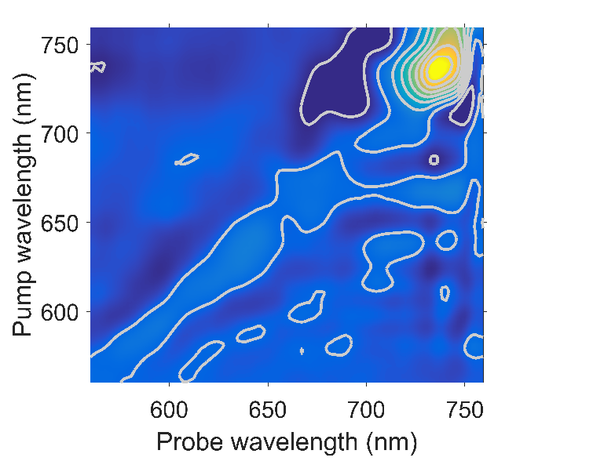
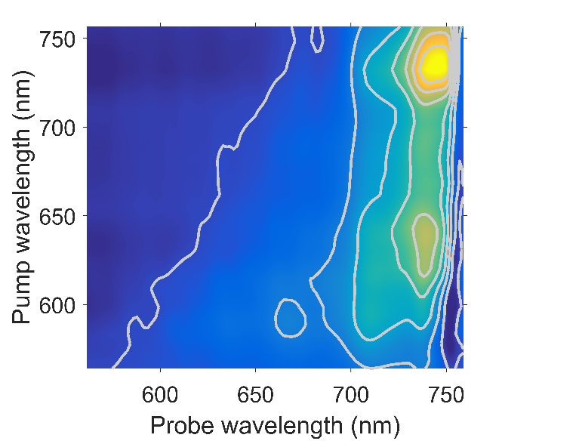
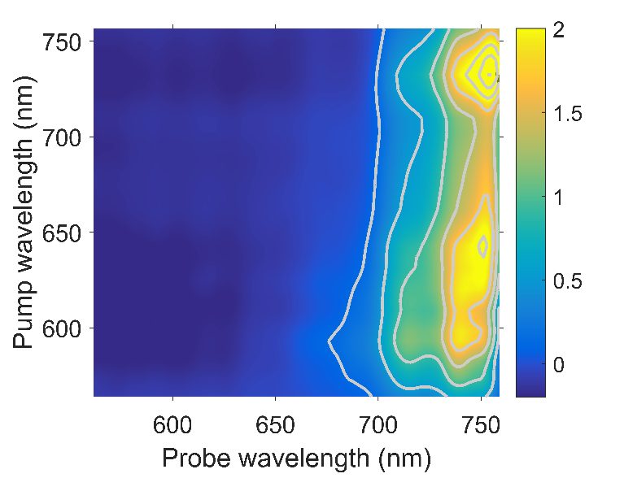
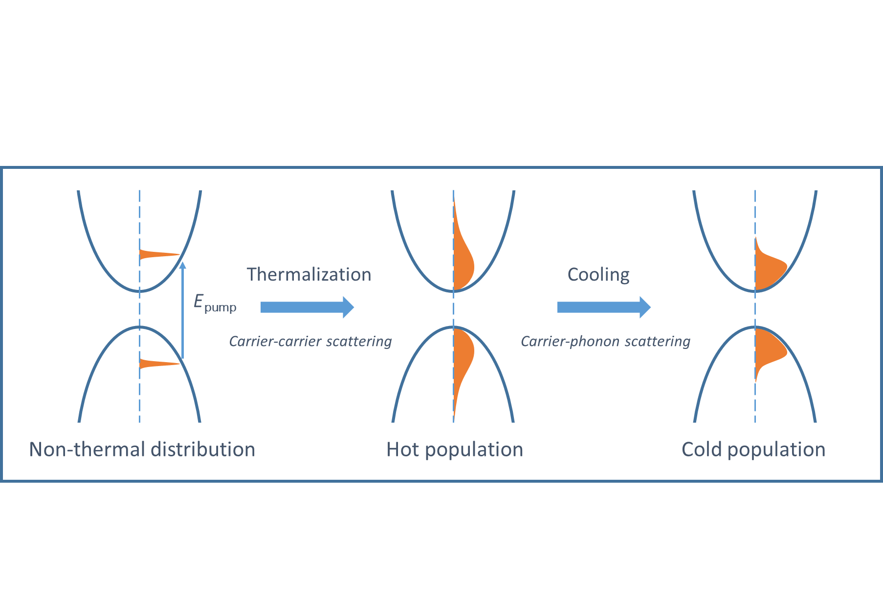
Figure 2
a
t₂ = 0 fs
b
t₂ = 80 fs
c
t₂ = 500 fs
Intensity (a.u.)
d

Slide 3
Figure 2d as vector graphic
Thermalization
Cooling
E_{pump}
Carrier-carrier scattering
Carrier-phonon scattering
Non-thermal distribution
Hot population
Cold population

Slide 4
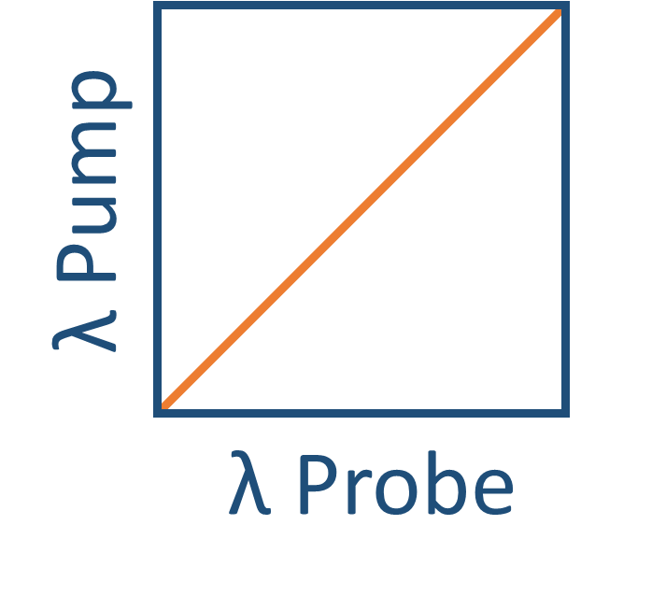
a
b
Figure 3
625 nm pump
Dephasing
Thermalization
Cooling
c
662 nm pump
d
720 nm pump

Slide 5
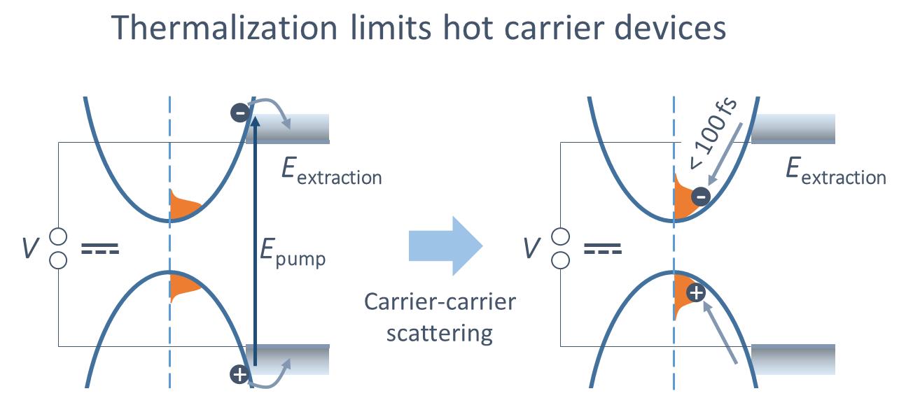
a
b
Figure 4
c

Slide 6


Figure 4c as vector graphic
Thermalization limits hot carrier devices
< 100 fs
E_{extraction}
E_{extraction}
V
E_{pump}
V
Carrier-carrier
scattering

